Slide 1
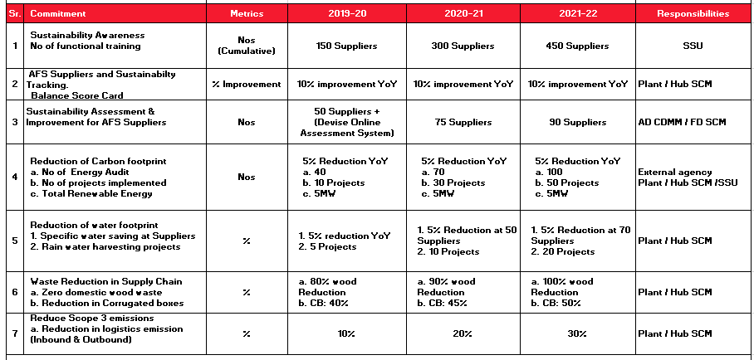
Supplier Sustainability Roadmap 2020-22

